Slide 1
CLAS 220 Introduction to Classical Mythology
Homer, Odyssey 13-19

Slide 2
Quiz Question
Which god or goddess appears to Odysseus when he wakes up on the beach at Ithaka?
Athena
Aphrodite
Thetis
Poseidon

Slide 3
Quiz Question
2. Who is Eumaios?
A loyal swineherd
One of the suitors
A disloyal goatherd
Telemachus’ long-lost brother

Slide 4
The second half of the poem
Odysseus arrives home exactly half-way through the Odyssey, at the start of Book 13.
Physical nostos, in other words, is only half the story.
Now he has to make it real.

Slide 5
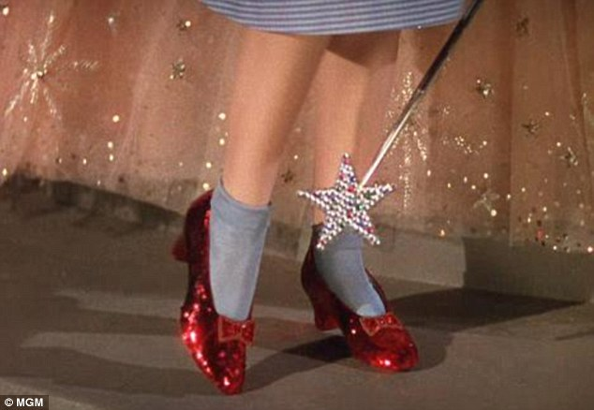
What we think nostos is like

Slide 6

What nostos is really like
The Perez Family
(Mira Nair, dir.) 1995
Couples who marry very young, and are separated for twenty years, don’t necessarily find it easy to reunite.

Slide 7
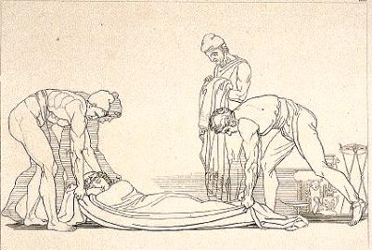
Odysseus Returns Home
Meanwhile, on his island,
His father’s shore, that kingly man, Odysseus,
Awoke, but could not tell what land it was
After so many years away; moreover,
Pallas Athena, Zeus’ daughter, poured
A grey mist all around him, hiding him
From common sight – for she had things to tell him
And wished no one to know him, wife or townsmen,
Before the suitors paid up for their crimes.
13.236-244

Slide 8
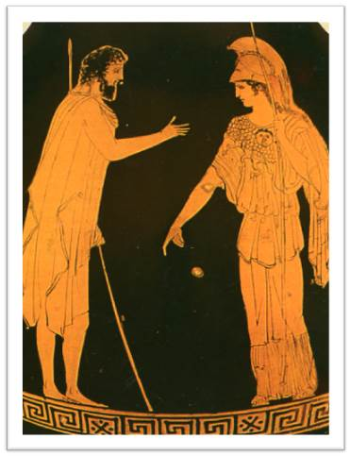
Odysseus and Athena
“Whoever gets around you must be sharp
And guileful as a snake; even a god
Might bow to you in ways of dissimulation.
You! You chameleon!
Bottomless bag of tricks! Here in your own country
Would you not give your stratagems a rest
Or stop spellbinding for an instant?”
13. 371-377

Slide 9
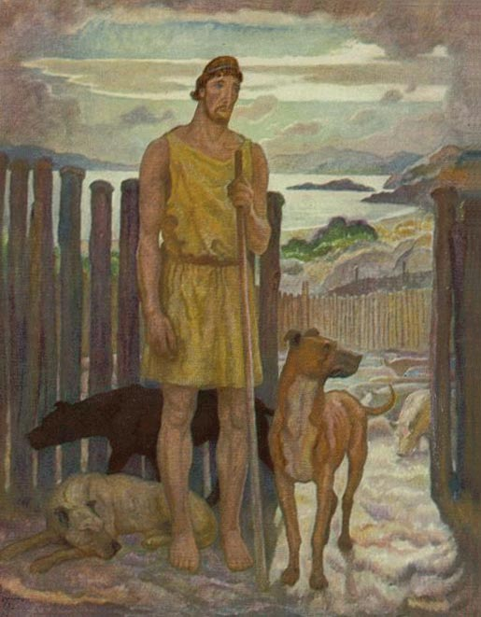
Odysseus and Eumaios
Rudeness to a stranger is not decency,
Poor though he may be, poorer than you. All wanderers
And beggars come from Zeus. What we can give
Is slight but well-meant – all we dare.
14. 68-71

Slide 10
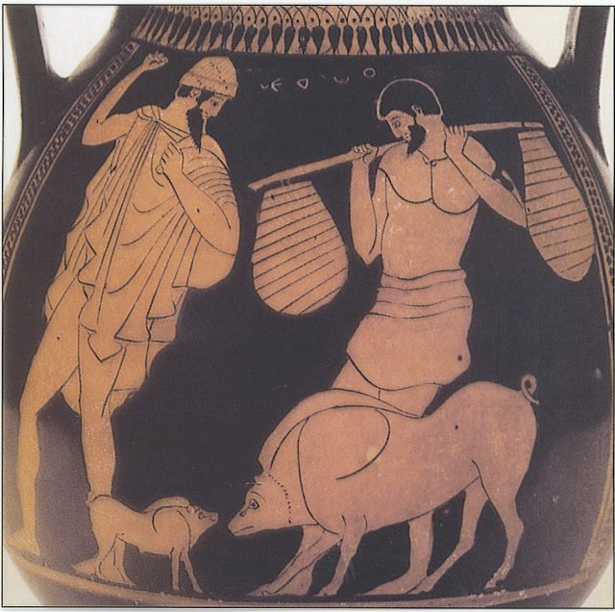
Odysseus Lies, and Lies, and Lies…
This time you are the derelict the Powers bring.
Well, give up trying to win me with false news
Or flattery. If I receive and shelter you,
It is not for your tales but for your trouble,
And with an eye to Zeus, who guards a guest.”
14. 450-455

Slide 11
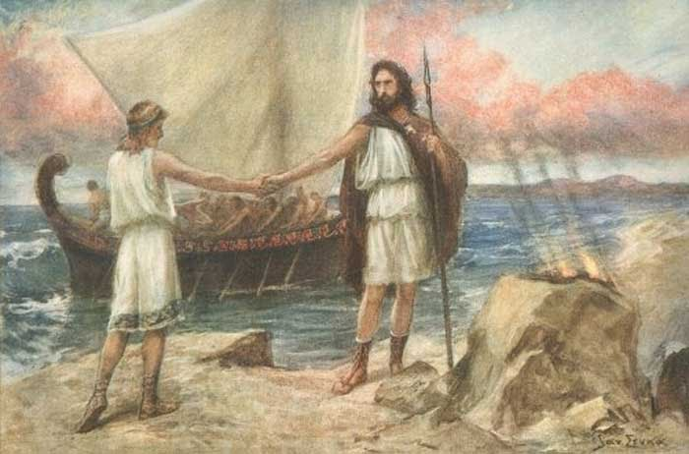
Theoklymenos speaks to Telemakhos
The words were barely spoken, when a hawk,
Apollo’s courier, flew up on the right,
Clutching a dove and plucking her – so feathers
Floated down to the ground between Telemakhos
And the moored cutter. Theoklymenos
Called him apart and gripped his hand, whispering,
“A god spoke in this bird-sign on the right.
I knew it when I saw the hawk fly over us.
There is no kinglier house than yours, Telemakhos,
Here in the realm of Ithaka. Your family
Will be in power forever.”
15.636-46

Slide 12
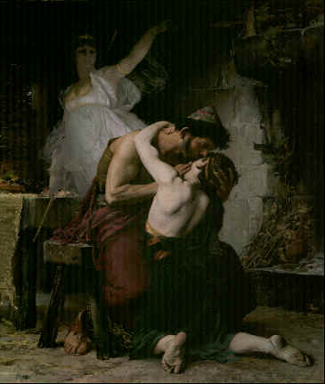
Father and Son Reunite
When he had spoken, down he sat. Then, throwing
His arms around this marvel of a father
Telemakhos began to weep. Salt tears
Rose from the wells of longing in both men,
And cries burst from both as keen and fluttering
As those of the great taloned hawk,
Whose nestlings farmers take before they fly.
So, helplessly, they cried, pouring out tears,
And might have gone on weeping so till sundown…
16. 253-261

Slide 13
Books 17-18: Odysseus tested in his own home
in these scenes, the disguised Odysseus returns to his own home for the first time
he gets to experience first-hand the way the suitors have behaved
he sees that he's arrived home only just in time

Slide 14
Quiz Question
3. What is the name of Odysseus’ dog?
Argos
Arktos
Aello
Scylax

Slide 15
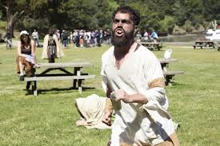
Melanthius
He was driving
A string of choice goats for the evening meal,
With two goatherds beside him; and no sooner
Had he laid eyes upon the wayfarers
Than he began to growl and taunt them both
So grossly that Odysseus’ heart grew hot:
“Here comes one scurvy type leading another!
God pairs them off together, every time.
Swineherd, where are you taking your new pig,
That stinking beggar there, licker of pots?
How many doorposts has he rubbed his back on
Whining for garbage, where a noble guest
Would rate a cauldron or a sword?”
17. 271-84

Slide 16
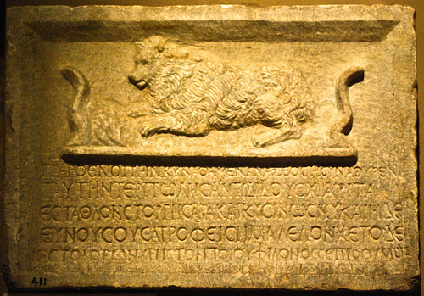
Dogs always know
While he spoke
An old hound, lying near, pricked up his ears
And lifted up his muzzle. This was Argos,
Trained as a puppy by Odysseus,
But never taken on a hunt before
His master sailed for Troy. The young men, afterward,
Hunted wild goats with him, and hare, and deer,
But he had grown old in his master’s absence.
Treated as rubbish now, he lay at last
Upon a mass of dung before the gates –
Manure of mules and cows, piled there until
Fieldhands could spread it on the king’s estate.
Abandoned there, and half destroyed with flies,
Old Argos lay. But when he knew he heard
Odysseus’ voice nearby, he did his best
To wag his tail, nose down, with flattened ears,
Having no strength to move nearer his master…
But death and darkness in that instant closed
The eyes of Argos, who had seen his master,
Odysseus, after twenty years.

Slide 17
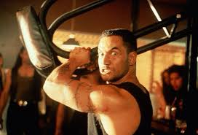
Suitors Behaving Badly
The stool he let fly hit the man’s right shoulder
On the packed muscle under the shoulder blade –
Like solid rock, for all the effect one saw.
Odysseus only shook his head, containing
Thoughts of bloody work, as he walked on,
Then sat, and dropped his loaded bag again…
17. 605-610

Slide 18
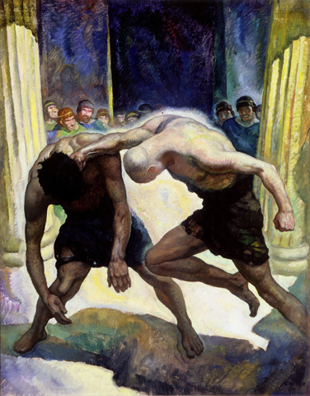
Fight! Fight! Fight!
And the tall full-blooded suitor, Antinoos,
Overhearing, broke into happy laughter.
Then he said to the others: “Oh my friends,
No luck like this ever turned up before!
What a farce heaven has brought this house! The stranger
And Iros have had words, they brag of boxing!
Into the ring they go, and no more talk!”
18. 41-49

Slide 19
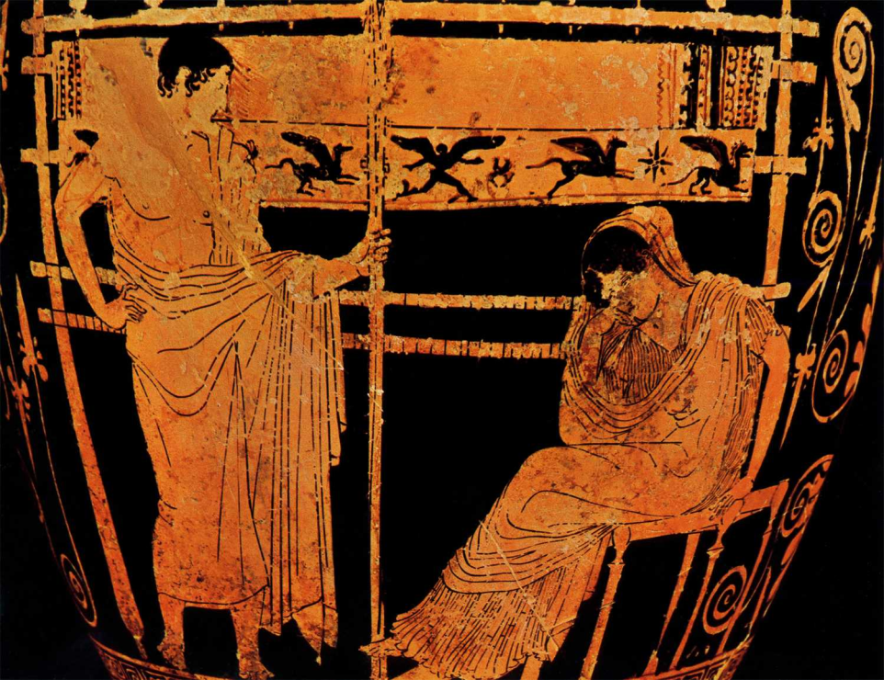
Mother and Son
Penelope:
Telemakhos, what has come over you?
Now you are full grown, come of age; a man
From foreign parts might take you for the son
Of royalty, to go by your good looks;
And have you no more thoughtfulness or manners?
Telemakhos:
… I know the meaning of these actions now,
Both good and bad. I had been young and blind.
How can I always keep to what his fair
While these sit here to put fear in me? – princes
From near and far whose interest is my ruin;
Are any on my side? But you should know
The suitors did not have their way, matching
The stranger here and Iros – for the stranger
Beat him to the ground….
18.270-293

Slide 20
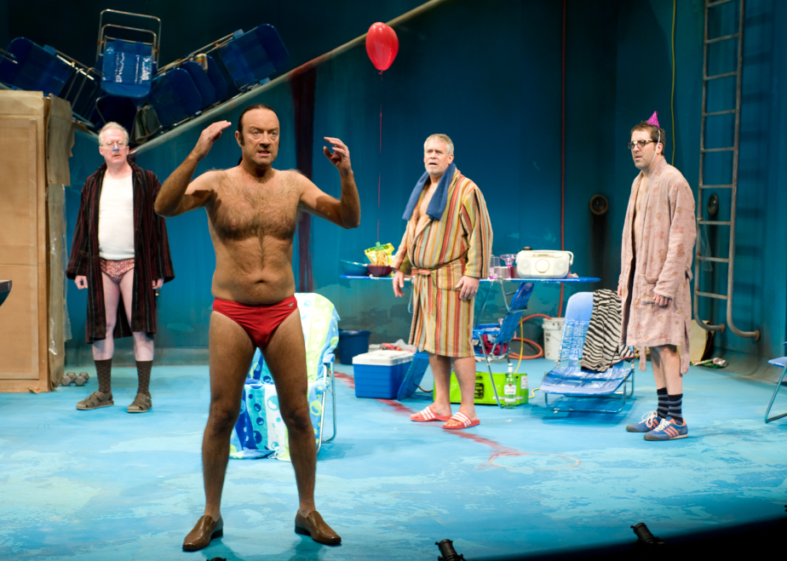
Penelope Confronts the Suitors
… wait for the beard to darken our boy’s cheek;
Then marry whom you will, and move away.”…
How galling, too,
To see newfangled manners in my suitors!
Others who go to court a gentlewoman,
Daughter of a rich house, if they are rivals,
Bring their own beeves and sheep along; her friends
Ought to be feasted, gifts are due to her;
Would any dare to live at her expense?”
Odysseus’ heart laughed when he heard all this…
18.336-49

Slide 21
Quiz Question
4. How does Eurykleia recognize Odysseus?
The ring on his finger
The sandals on his feet
The scar on his thigh
The missing finger on his left hand

Slide 22
Penelope and the Disguised Odysseus
preparation for their later full recognition
Odysseus tests Penelope (and Eurykleia)
if Penelope recognizes Odysseus, she tests him

Slide 23
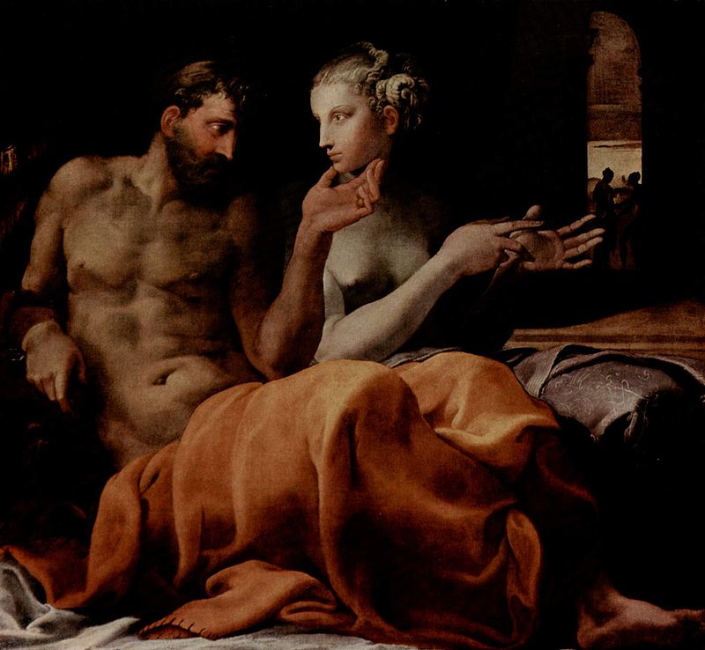
Odysseus’ Memories of Odysseus
“Lady, so long a time now lies between,
It is hard to speak of it. Here is the twentieth year
Since that man left the island of my father.
But I shall tell what memory calls to mind.
A purple cloak, and fleecy, he had on –
A double thick one. Then, he wore a brooch
Made of pure gold with twin tubes for the prongs,
And on the face a work of art: a hunting dog
Pinning a spotted fawn in agony
Between his forepaws – wonderful to see
How being gold, and nothing more, he bit
The golden deer convulsed, with wild hooves flying.
Odysseus’ shirt I noticed, too – a fine
Closefitting tunic like dry onion skin,
So soft it was, and shiny. Women there,
Many of them, would cast their eyes on it.
19.262-70

Slide 24
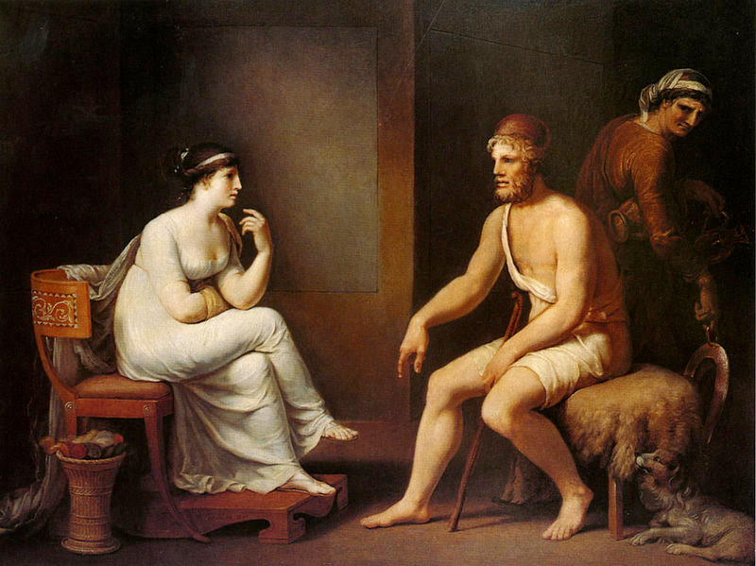
Odysseus suggests Odysseus will return
You see, then, he is alive and well, and headed
Homeward now, no more to be abroad
Far from his island, his dear wife and son,
Here is my sworn word for it. Witness this,
God of the zenith, noblest of the gods,
And Lord Odysseus’ hearthfire, now before me:
I swear these things shall turn out as I say.
Between this present dark and one day’s ebb,
After the wane, before the crescent moon,
Odysseus will come.”
19. 353-362

Slide 25
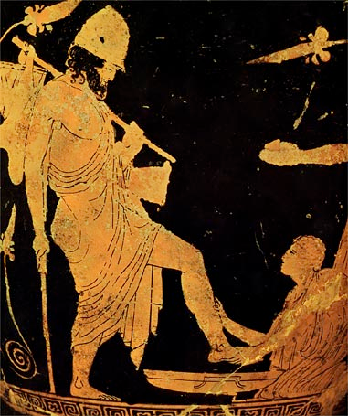
The Scar….
Then he kept still, while the old nurse filled up
Her basin glittering in firelight; she poured
Cold water in, then hot. But Lord Odysseus
Whirled suddenly from the fire to face the dark.
The scar: he had forgotten that. She must not
Handle his scarred thigh, or the game was up.
But when she bared her lord’s leg, bending near,
She knew the groove at once. An old wound
A boar’s white tusk inflicted, on Parnassos
Years ago. He had gone hunting there…
19.451-62

Slide 26
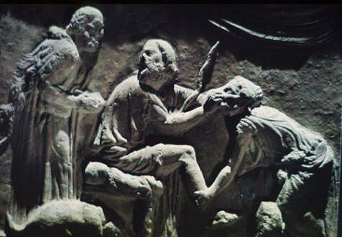
continued
This was the scar the old nurse recognized;
She traced it under her spread hands, then let go,
And into the basin fell the lower leg
Making the bronze clang, sloshing the water out.
Then joy and anguish seized her heart; her eyes
Filled up with tears; her throat closed, and she whispered,
With hand held out to touch his chin: “Oh yes!
You are Odysseus!
19.542-50

Slide 27
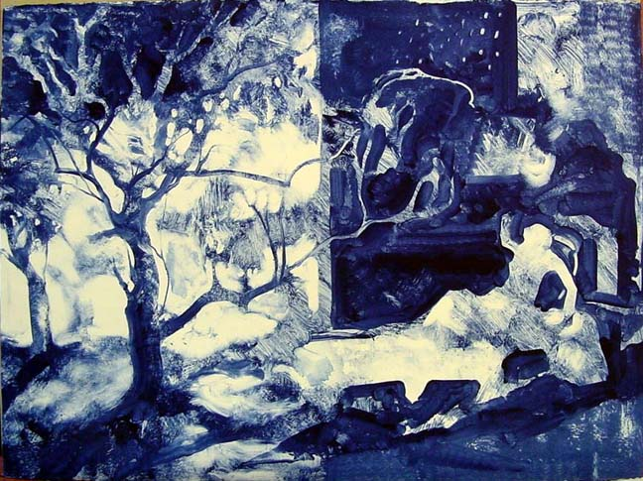
Penelope’s Dream
Interpret me this dream: From a water’s edge
Twenty fat geese have come to feed on grain
Beside my house. And I delight to see them.
But now a mountain eagle with great wings
And crooked beak storms in to break their necks
And strew their bodies here. Away he soars
Into the bright sky, and I cry aloud –
All this in dream – I wail and round me gather
Softly braided Akhaian women mourning
Because the eagle killed my geese. Then down
Out of the sky he drops to a cornice beam
With mortal voice telling me not to weep.
‘Be glad,’ says he, ‘renowned Ikarios’ daughter:
Here is no dream but something real as day,
Something about to happen. All those geese
Were suitors, and the bird was I. See now,
I am no eagle but your lord come back
To bring inglorious death upon them all!’
As he said this, my honeyed slumber left me.
Peering through half-shut eyes, I saw the geese
In hall, still feeding at the self-same trough.”
19.621-41

Slide 28
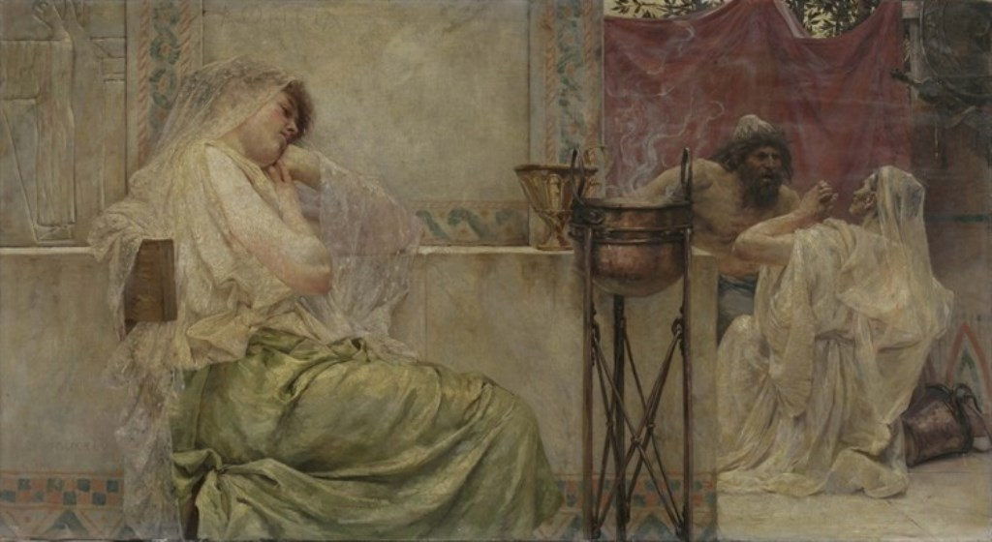
Disguised Odysseus responds
My dear, how can you choose to read the dream
Differently? Has not Odysseus himself
Shown you what is to come? Death to the suitors,
Sure death, too. Not one escapes his doom.”
19. 644-647

Slide 29
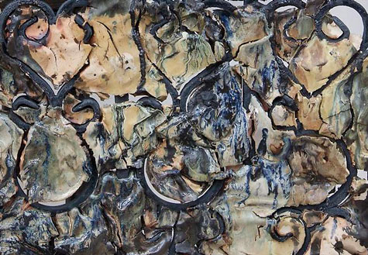
Penelope responds back
Two gates for ghostly dreams there are: one gateway
Of honest horn, and one of ivory.
Issuing by the ivory gate are dreams
Of glimmering illusion, fantasies,
But those that come through solid polished horn
May be borne out, if mortals only know them.
I doubt it came by horn, my fearful dream –
Too good to be true, that, for my son and me.
19.652-9

Slide 30
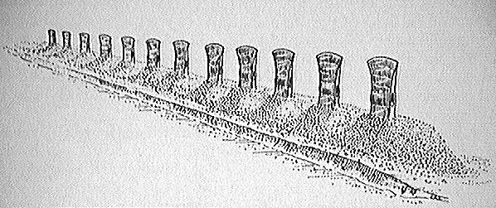
One More Thing…
I shall decree a contest for the day.
We have twelve axe heads. In his time, my lord
Could line them up, all twelve, at intervals
Like a ship’s ribbing; then he’d back away
A long way off and whip an arrow through.
Now I’ll impose this trial on the suitors.
19.663-8

Slide 31
Quiz Question
5. What animals appear in Penelope’s dream?
Twenty geese and an eagle
Twelve boars and a lion
Five partridges and a cat
Sixteen dolphins and a shark

